Slide 1
Colorado Federation Conference May 25, 2023 Membership Overview
Jacqueline Bryant – Coordinator Member Engagement
jbryant@narfe.org

Slide 2
Membership Strategy
Key Elements
Enhance digital marketing & communication efforts
Create multiple paths for prospects to experience and join NARFE (NAREF websites, partnerships)
Increase member retention through engagement, especially within first-year and overall
Enhance tools and support for field recruiting and leadership development
Target active Feds—offer better, more relevant content
EMPHASIZE the VALUE

Slide 3
National Recruitment
Lead Generation/Acquisition
Direct mail to prospects and lapsed members
Targeted digital marketing
Membership marketing e-blasts to Fed publications (FedWeek, FedManager)
Online and social media (Google Ads/Linkedln/Facebook)
Online outlets (FNN-Federal News Network, FedForum, etc.)
Promote our webinars and to select NARFE resources to generate leads.
NARFE.org
Easier for users to find info, easier for us to capture info.

Slide 4
National Recruitment
Organizational Relationships
Share select NARFE resources in exchange for exposure to key target audiences
Partner shares NARFE messaging and brand
Attract prospective members and acquire contact info
Associations
NAIJ – National Association of Immigration of Judges
FMA – Financial Management Association
FEW – Federal Employed Woman
BIG – Black in Government
FDR – Fed Dispute Resolution, training

Slide 5
Renewal/Retention
Member Engagement
Updated renewal/dues notice process
Tightened up mailing schedule and updated messaging,
Purging invalid contact information (addresses) etc.
With the help of our local chapters, we can capture members before they drop and or lapsed in membership (retention)
Survey, Email
Increased emphasis on membership value
Better promotion of key resources and benefits
Deliver message across multiple platforms
NARFE Magazine, NewsLine, NARFE.org, e-blast and your Federation and chapter website.
Hold joint and or local chapter events (virtual – in person)
Invite experts, union groups, fed agency, research to find what interest their community

Slide 6
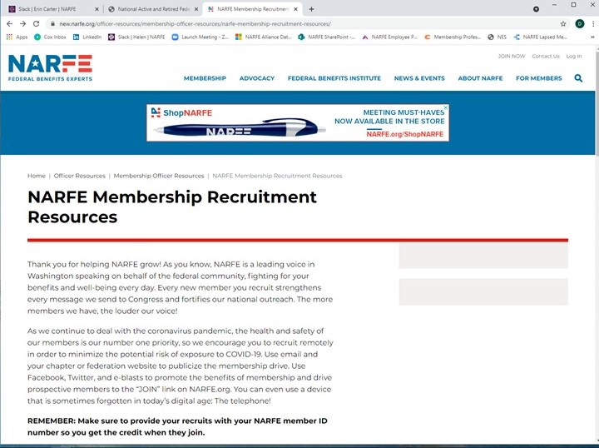
Local Recruitment/Retention Resources
NARFE Recruitment Resources page
To help members recruit
Continue to add and update
Recruitment letter/email template
Sample ads
Presentation Resources
“About NARFE” video (YouTube)
Membership presentation script
Membership PowerPoint slide deck
NARFE Recruitment/Retention Team
Printed materials, magazines (F-18 Online form)
membership@narfe.org

Slide 7
Retention Resource

Slide 8
Local Recruitment/Retention Resources
NARFE Design Services
Advertise in local publications that reach active Feds
e.g., Wright-Patterson AFB, Ohio—Skywrighter
HQ will design them for you
Print and digital

Slide 9
Local Recruitment/Retention Ideas
Personal Connections
Fall Membership Drive (Sept 1 thru December 31)
Essential to get members involved at the grassroots level
“If every current member recruited just one new member…”
Colleagues still active in federal workforce
Drop NARFE mags/flyers in common areas at their agencies
Meeting presentations (virtual or in-person)
Health insurance reps, union meetings
Hold joint events with relevant local groups
Local senior centers
Other Fed retiree organizations
Invite experts, legislative reps, etc., to speak

Slide 10
National Visibility & Brand Awareness
Brand Awareness
Advertise in local publications that reach active Feds
HQ will design them for you
Public Service Recognition Week and throughout the month of May
Thank active and retired federal employees and military service member for their service
Raise awareness of diverse professions within federal workforce and the talented individuals who serve our nation

Slide 11
Helping to Promote NARFE Chapters
NARFE’s Local Presence
Promote chapter membership in all renewal and acquisition mailings
A chance to get involved and meet other members in your area
New opportunity to connect online
Chapter Spotlight
Website federation/chapter section

Slide 12
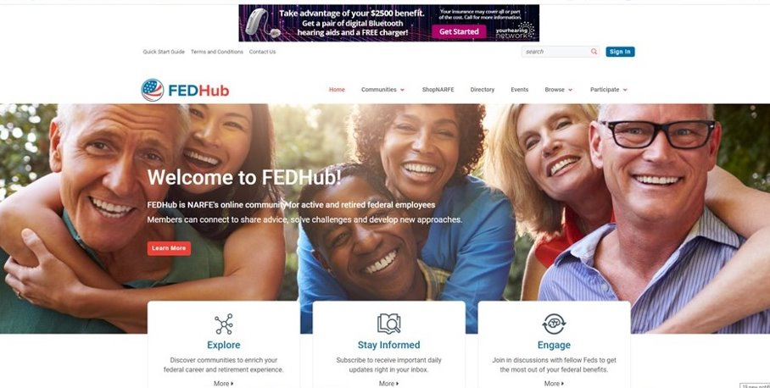
FEDHub: The NARFE Online Member Community

Slide 13
FEDHub: The NARFE Online Member Community
Connecting NARFE members across town and across the country
Open Forum and topic-specific communities
Libraries where members can share helpful resources
Articles, blog posts, images, chapter newsletters, etc.
NARFE members have exclusive access to post content
Prospective members can read content in certain communities
Use to engage and recruit new NARFE members

Slide 14
Why FEDHub?
Member engagement
Dedicated communities connect members virtually at the federation/chapter level
Convenient online platform to increase participation
Topic-specific
Connect and share ideas and solutions across town and country
Federation/Chapter/Officer communities
Improve member communication
Automated messaging incorporated into welcome/onboarding (1st year) and ongoing communication
Drive engagement & promote stronger connection to NARFE

Slide 15
Why FEDHub?
Attract prospective members
NARFE Membership Strategy – “A path to membership”
Educational content greatly enhances SEO, driving platform higher in results for the terms our target audience is searching
Visitors can view discussions—when they try to interact, they’ll be routed to membership promo and prompted to provide their contact info to learn more
System targets prospects with emails to engage with NARFE and get them to join

Slide 16
FEDHub Chapter/Federation Communities
Enable chapter/federation leaders to communicate directly with chapter members via HL community email functionality
Email announcements, newsletters, attachments, etc., to their full member list
Foster engagement with chapter members by attracting them to the community on FEDHub
Post announcements, newsletters, etc., to the community
Receive email notification to view post
Start discussions, engage with members by regularly posting content
FEDHub.narfe.org

Slide 17
Questions

Slide 18
Thank you! Jackie Bryant jbryant@narfe.org

